Slide 1

Exercise 3:
Short- and Long-run Paid Search Advertising Response
BY TEAM 3

Slide 2
Content:
Short-run response
Simple linear model
Concave model
Assessment and conclusion
Long-run response
Simple linear model with advertising carry-over effects
Concave model with advertising carry-over effects
Assessment and conclusion
Saturation

Slide 3
Short-run response

Slide 4
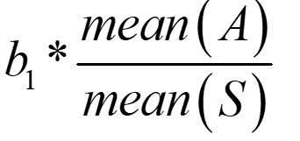
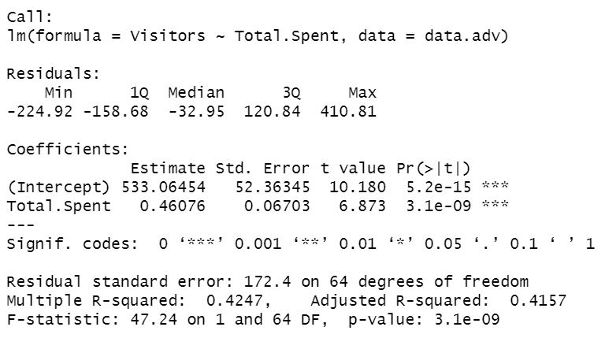
Simple linear model
Model
Advertising elasticity
Decent R Squared of 0.43
Advertising spend has significant impact on clicks of the same period
Using July’s monthly clicks and advertising spend
Advertising elasticity = 0.2642
If advertising spend increases by 1%, number of clicks/visitors will increase by 0.26%

Slide 5
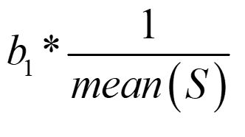
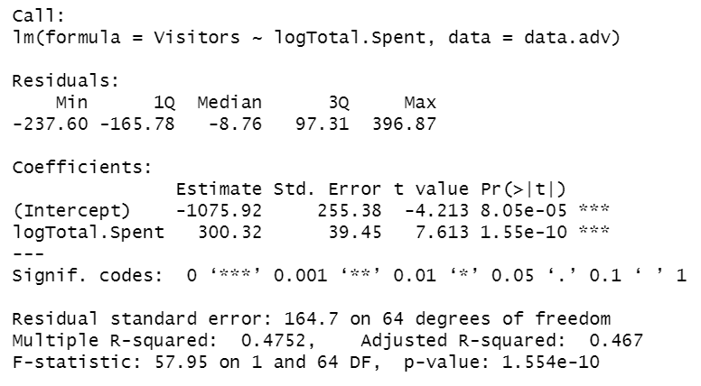
Concave model
Model
Advertising elasticity
Higher R Squared than simple linear model (0.48)
Log(advertising spend) has significant impact on clicks of the same period
Using July’s monthly clicks and advertising spend
Advertising elasticity = 0.3013
If advertising spend increases by 1%, number of clicks/visitors will increase by 0.3%

Slide 6
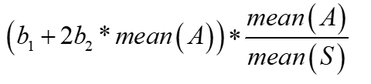
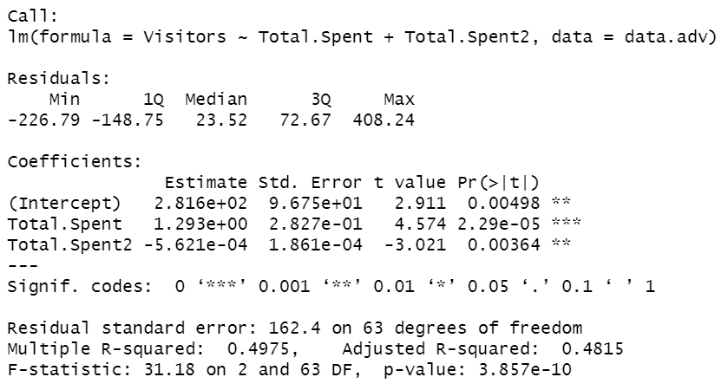
Concave quadratic model
Model
Advertising elasticity
Highest R Squared among 3 short-run models (0.50)
Both advertising spend and its squared term are significant predictors of clicks in the same period
Using July’s monthly clicks and advertising spend
Advertising elasticity = 0.3731
If advertising spend increases by 1%, number of clicks/visitors will increase by 0.37%

Slide 7
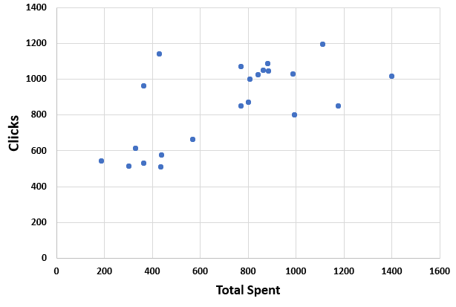
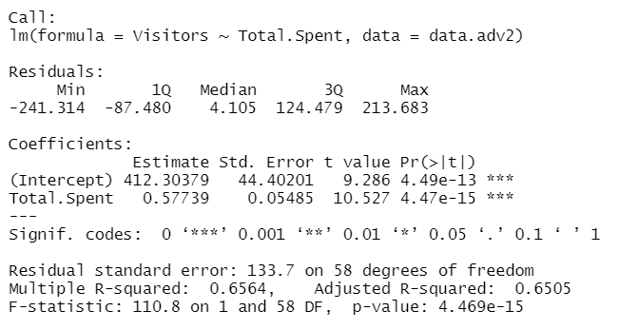
Assessment and conclusion
Concave quadratic model has the highest R Squared among 3 short-run models (0.50), as well as the lowest residual standard error. It can be used to model extreme scenarios and calculate saturation point
Simple linear model is decent for estimating localized area of the response curve but estimations on the lower end of advertising spend might not be accurate (the actual data does not show a perfect linear relationship with some higher clicks associated with low advertising spend on the left end)
It would be useful to investigate the reasons behind the outliers (low advertising spend and high clicks). If these are removed, a simple linear model will fit better (as shown by a higher R Squared on the right)
Model after removing two extreme observations

Slide 8
Long-run response

Slide 9
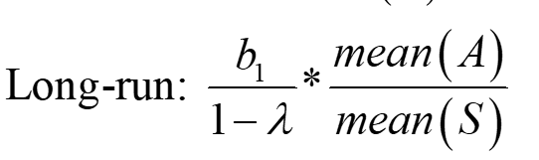
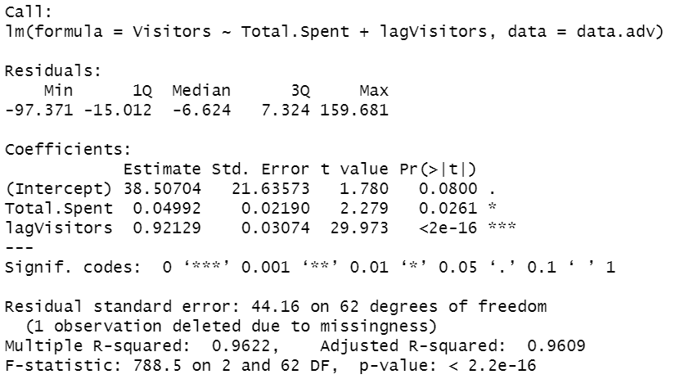
Simple linear model with advertising carry-over effects
Model
Advertising elasticity
High R Squared of 0.96
Both advertising spend of the same period and clicks of the previous period have significant impact on clicks
Using July’s monthly clicks and advertising spend
Advertising elasticity = 0.3636
If advertising spend increases by 1%, number of clicks/visitors will increase by 0.36% in the long run

Slide 10
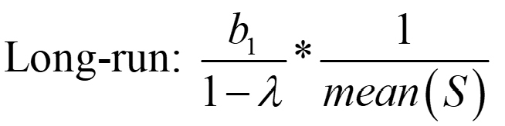
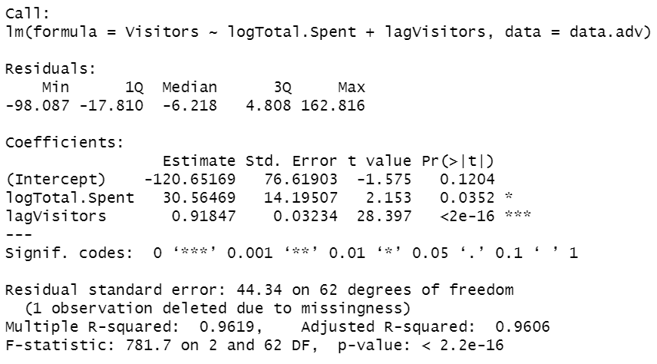
Concave model with advertising carry-over effects
Model
Advertising elasticity
Similar R Squared to simple linear model (0.96)
Both log(advertising spend) of the same period and clicks of the previous period have significant impact on clicks
Using July’s monthly clicks and advertising spend
Advertising elasticity = 0.3762
If advertising spend increases by 1%, number of clicks/visitors will increase by 0.38% in the long run

Slide 11
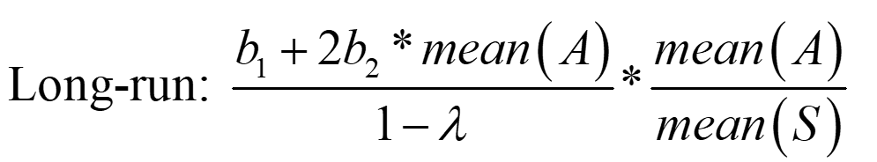
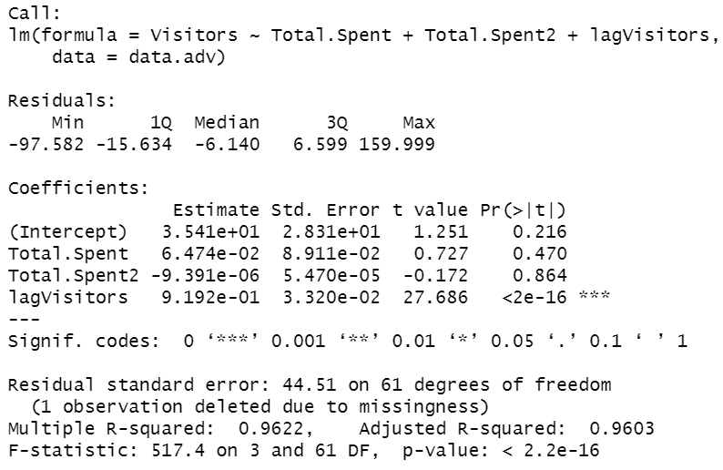
Concave quadratic model with advertising carry-over effects
Model
Advertising elasticity
Similar R Squared to the other two models
Only clicks from the previous period remain significant
Advertising spend no longer has significant impact
Using July’s monthly clicks and advertising spend
Advertising elasticity = 0.3834
If advertising spend increases by 1%, number of clicks/visitors will increase by 0.38% in the long run

Slide 12
Assessment and conclusion
Models with long-run response perform better than models with short-run response. Incorporating advertising carry-over effects significantly improves the model fit (with R Squared increasing from 0.42-0.49 to 0.96)
Given that all three long-run models perform similarly well, simple linear model with advertising carry-over effects will be a good choice as it is simple, easy to implement, all of the predictors are significant
The best model among the 6 models is the simple linear model with advertising carry-over effects given its high R Squared, low residual standard error and simplicity

Slide 13
Saturation

Slide 14
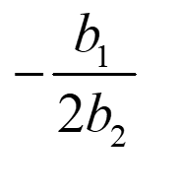
Concave quadratic model
Model
Saturation level
Saturation level = 1150.322
Clicks will start to decline when daily advertising goes beyond $1150
This model has a smaller saturation point than the one with advertising carry-over effects

Slide 15
Concave quadratic model with advertising carry-over effects
Model
Saturation level
Saturation level = 3447.066
Clicks will start to decline when daily advertising goes beyond $3447
This model has a significantly higher saturation point than the one without advertising carry-over effects

